Slide 1

Time Series Nvidia
Vincent

Slide 2
AGENDA
Data Collection and Preprocessing
Model Building
Model Evaluation
Reasoning and Improvements

Slide 3
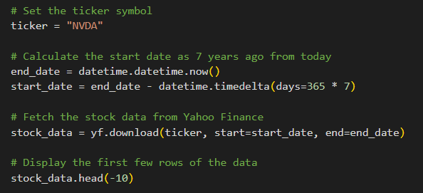
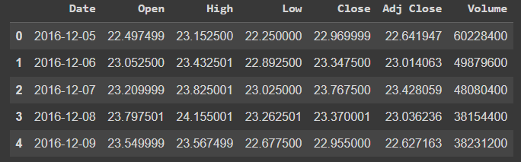
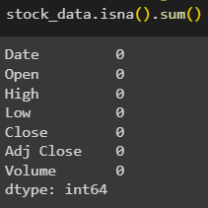
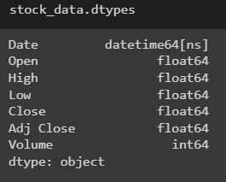
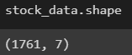
Data Collection and Preprocessing

Slide 4
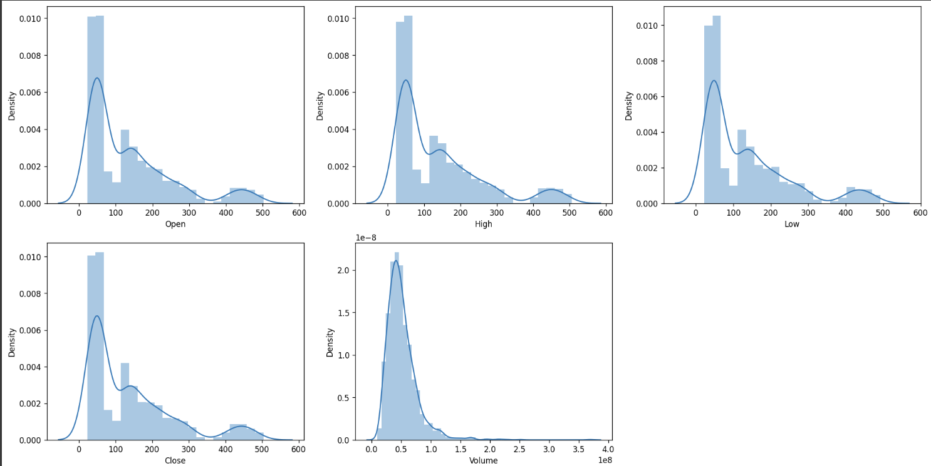
Histogram on all columns

Slide 5
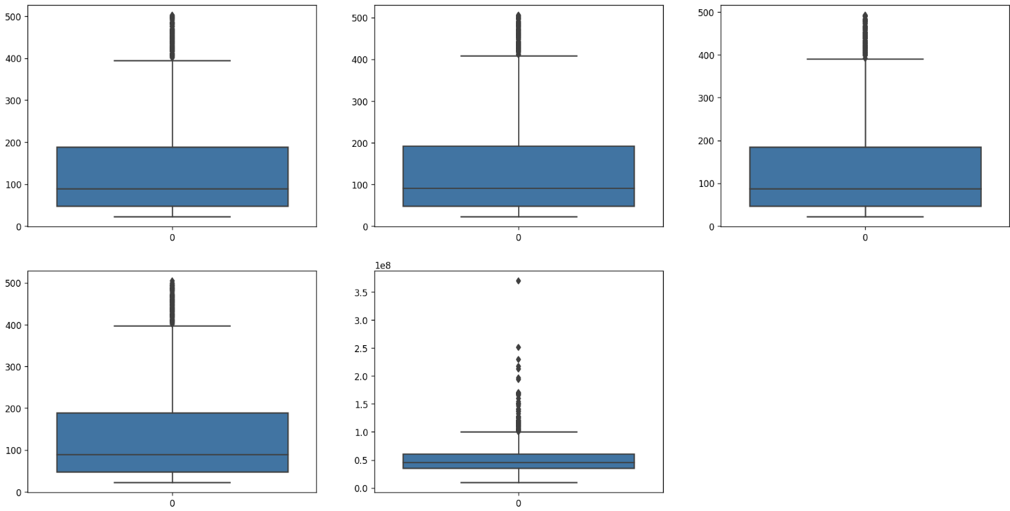
Boxplot on all columns

Slide 6
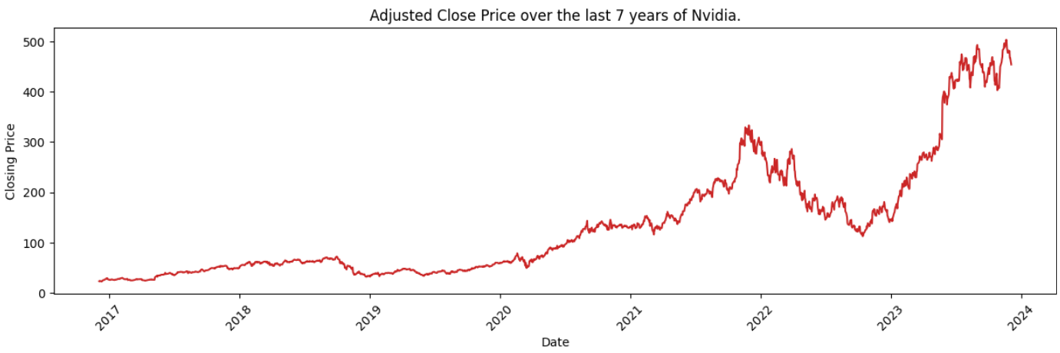
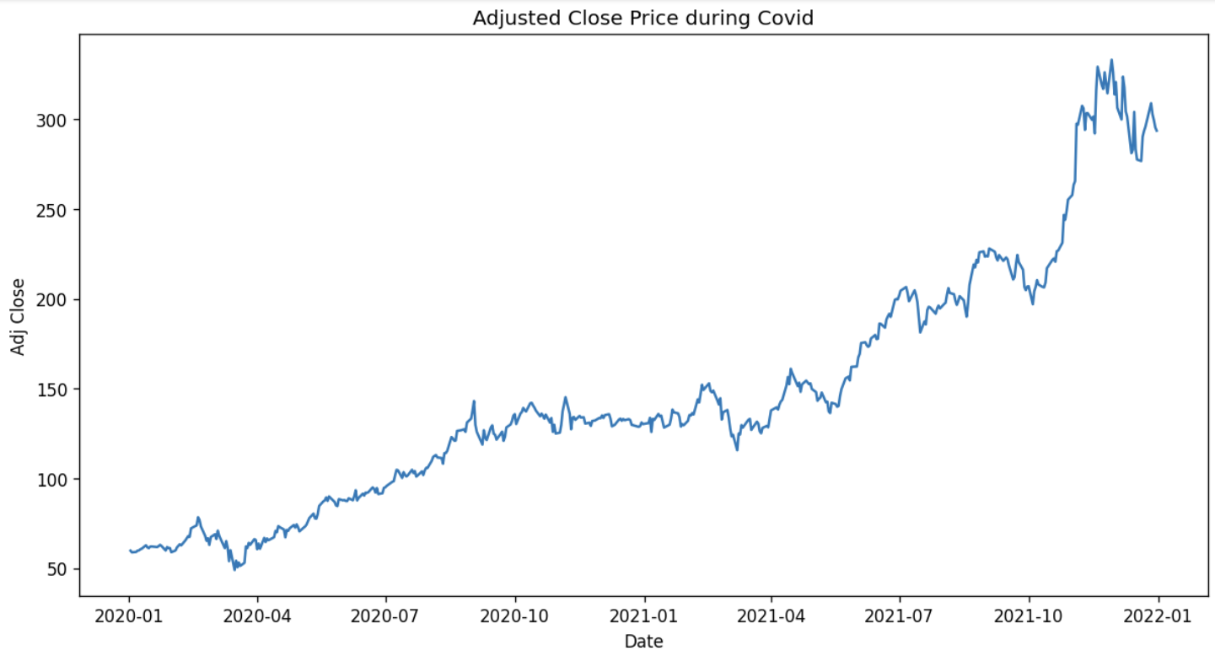

Slide 7
Model Building

Slide 8
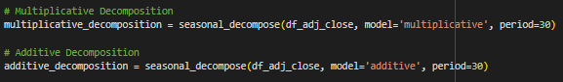
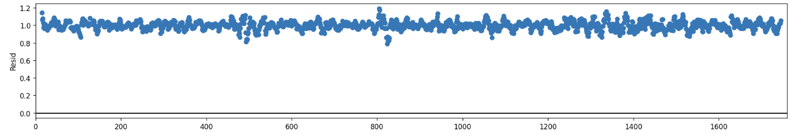
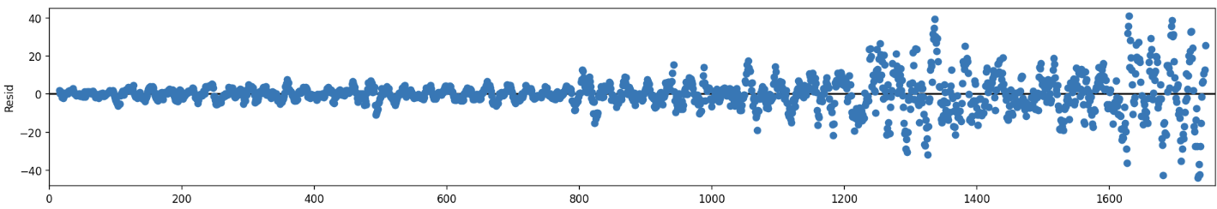
Decomposition
Multiplicative
Additive

Slide 9
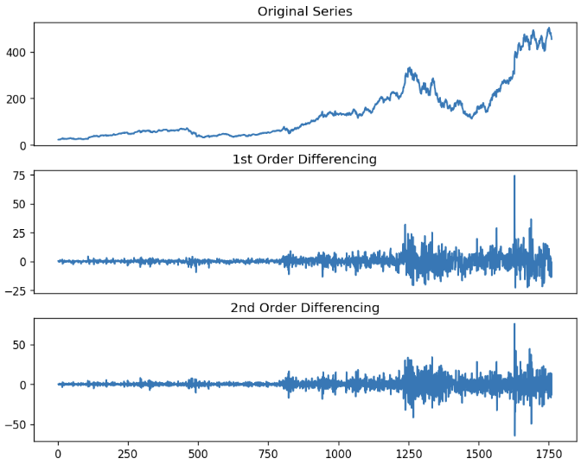
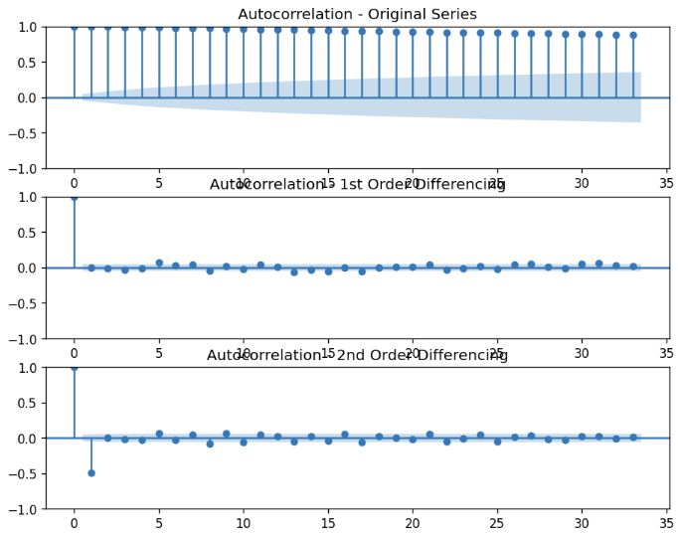
Finding The parameters

Slide 10
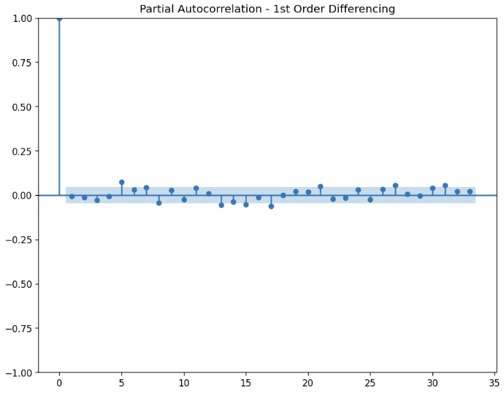
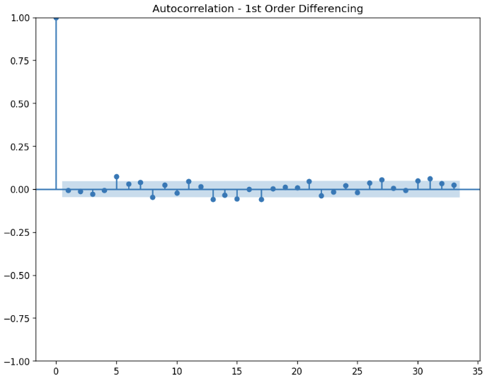
Finding The parameters

Slide 11
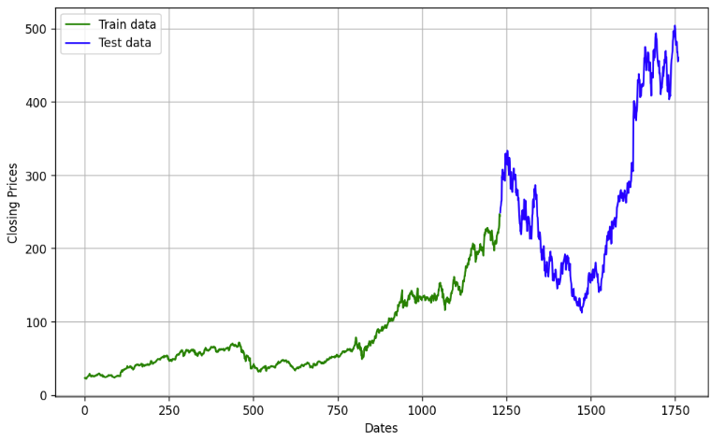
Model Building

Slide 12
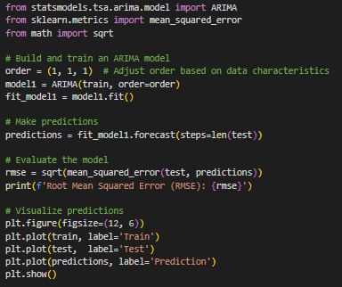
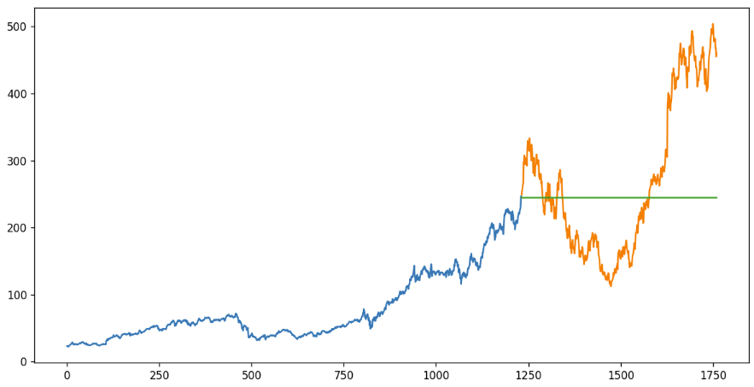
Model 1

Slide 13
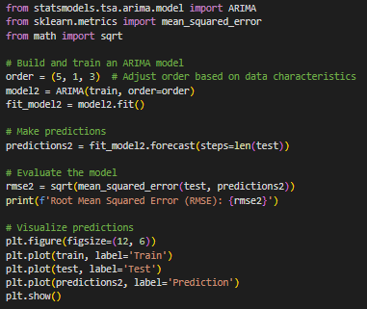
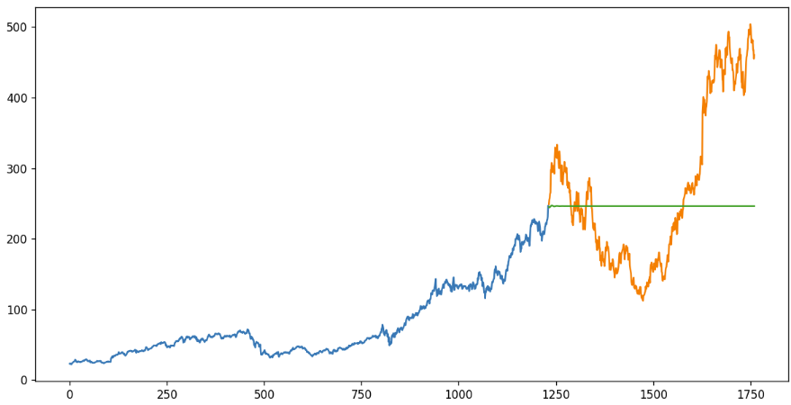
Model 2

Slide 14
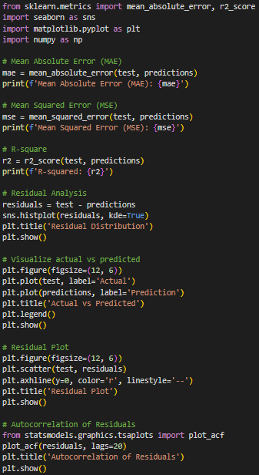
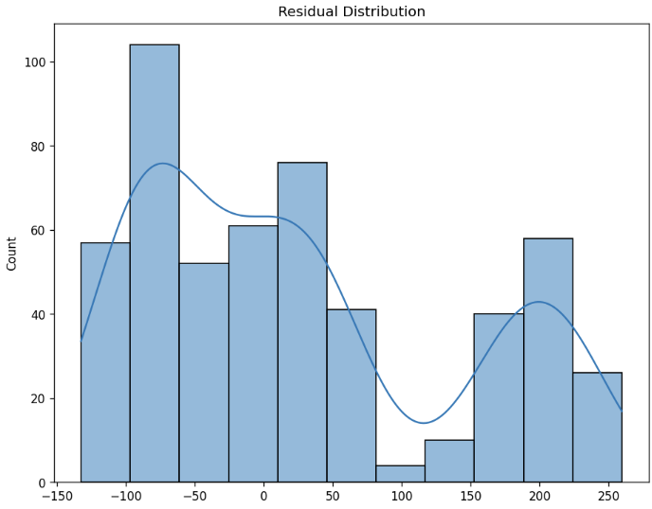
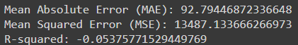
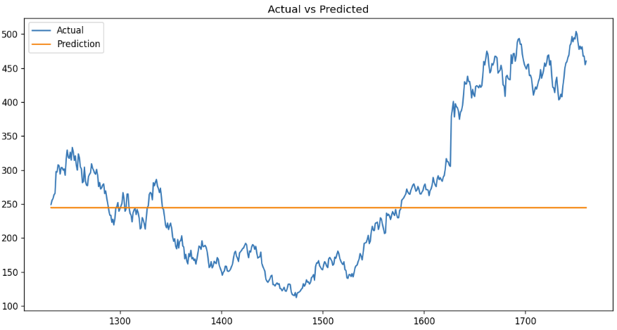
Model 1 Evaluation

Slide 15
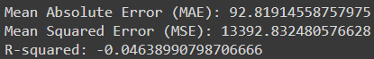
Model 2 Evaluation

Slide 16
Conclusion and How to be better?
Model Is Bad
Model Optimization
Negative R score
Bad Residuals
Horizontal Line as Prediction
Too Complex Data
Auto Arima optimization
Feature Programming
Hyperparameter Optimization
Different Model Use
LSTM Machine Learning Models
SARIMAX model

Slide 17
THANK YOU
Vincent Mostert
vmostert@student.hult.edu

